Slide 1

Vision Based Volumetric Flow Measurement for wastewater and Storm water Networks
SeyedMojtaba Noghabaei
North Carolina State University

Slide 2
Outline
Observed problems
Literature review
Proposed solution
System architecture
Pipe 3d models and image processing
Limitations and future works

Slide 3
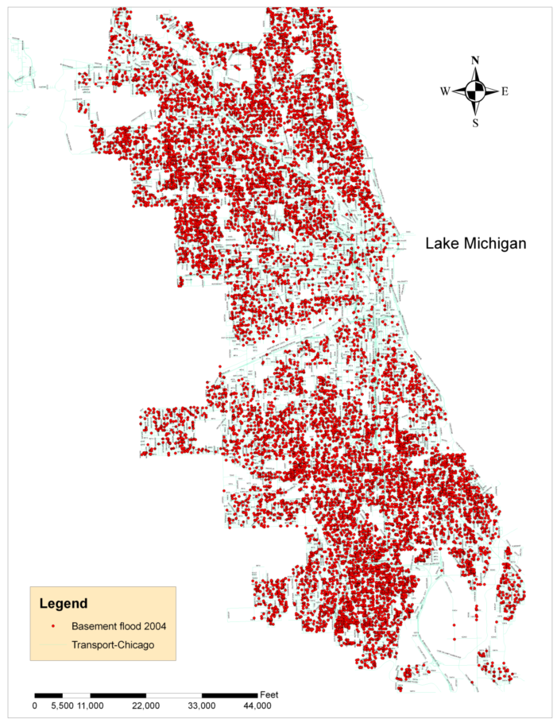
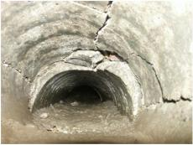
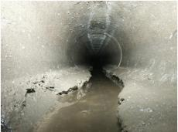
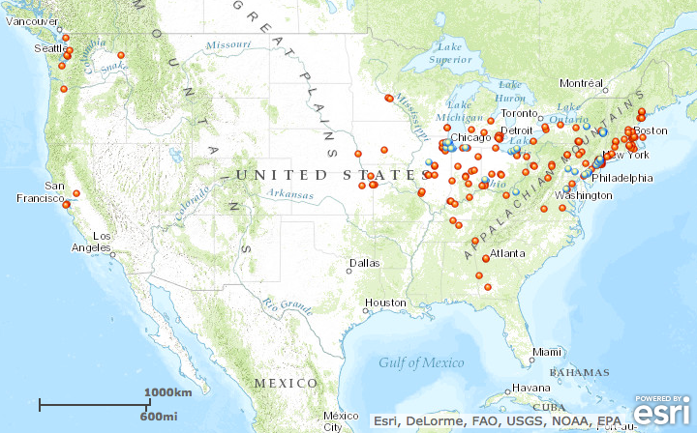
Observed Problems
Overflow in storm water network
Pipe cracks and clogging
Detecting which pipes need cleaning
Basement flooding complaints documented in Chicago during 2004

Slide 4
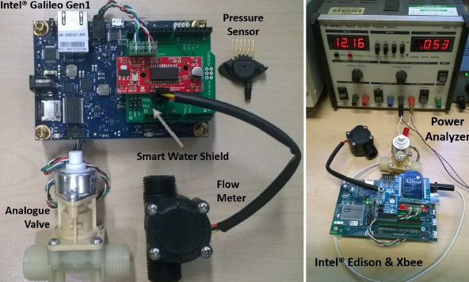
Literature Review
WaterBox: A Testbed for Monitoring and Controlling Smart Water Networks
Ideas:
Water network
Intel Galileo Gen 1 ($80)
Pressure sensor
Flow meter
Analogue valve
Limitations:
Needs high voltage(12v)
Needs wire for power
Expensive components
Notes:
It is not possible to power the device with batteries

Slide 5
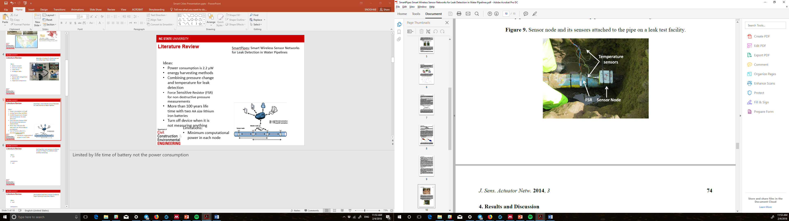
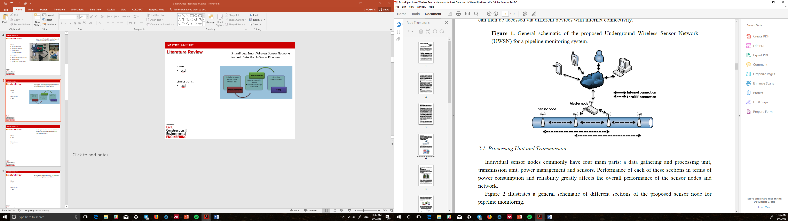
Literature Review
SmartPipes: Smart Wireless Sensor Networks for Leak Detection in Water Pipelines
Ideas:
Power consumption is 2.2 μW
energy harvesting methods
Combining pressure change and temperature for leak detection
Force Sensitive Resistor (FSR) for non destructive pressure measurements
More than 100 years life time with two AA size lithium iron batteries
Turn off device when it is not measuring anything
Limitations:
Minimum computational power in each node
Notes:
Limited by life time of battery not the power consumption

Slide 6

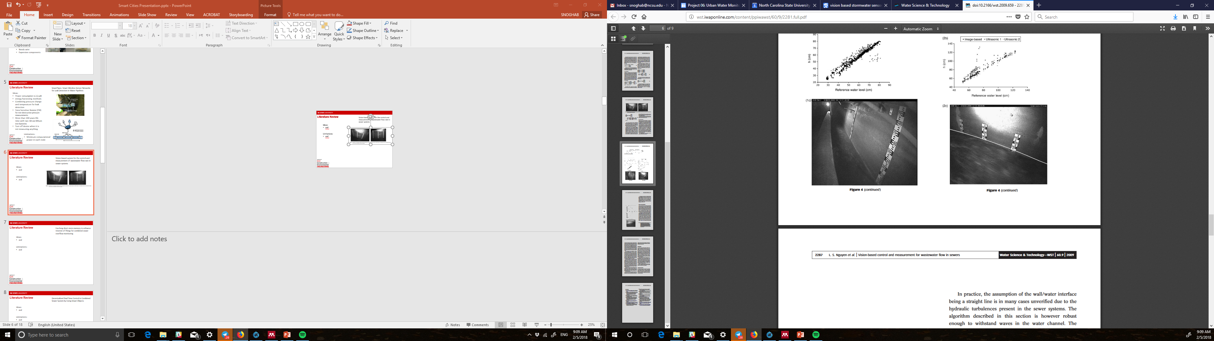
Literature Review
Vision-based system for the control and measurement of wastewater flow rate in sewer systems
Ideas:
Using vision based sensors
Add lights
Limitations:
Only in large channels or pipes
High price (US$11K)
Didn’t use advanced image processing approach
Notes:
Wall mounted meters

Slide 7
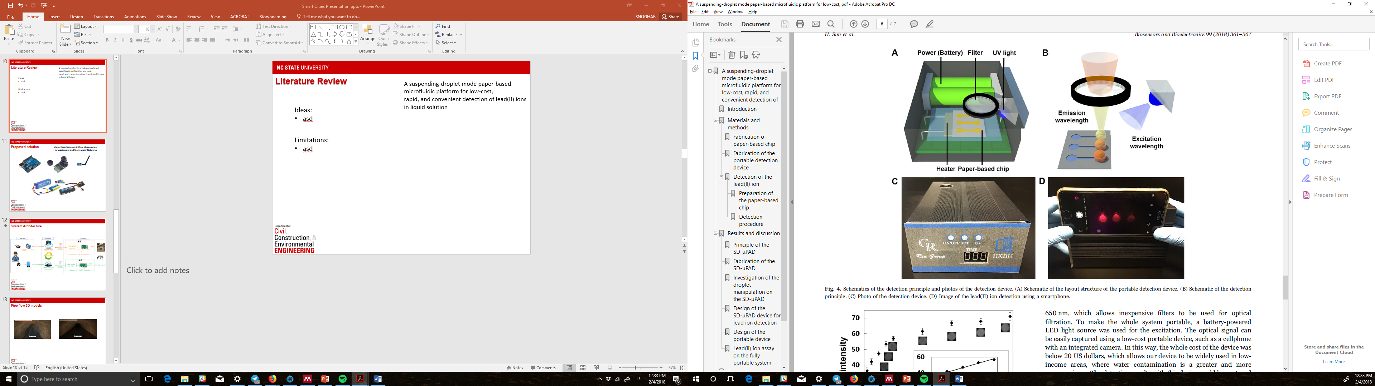
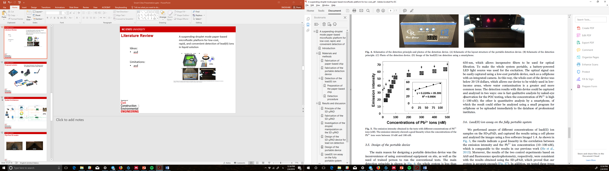
Literature Review
A suspending-droplet mode paper-based microfluidic platform for low-cost,
rapid, and convenient detection of lead(II) ions in liquid solution
Ideas:
pb ion detection
Non destructive test
Water quality measurements
Limitations:
Need large battery and UV light
Relatively expensive technology

Slide 8

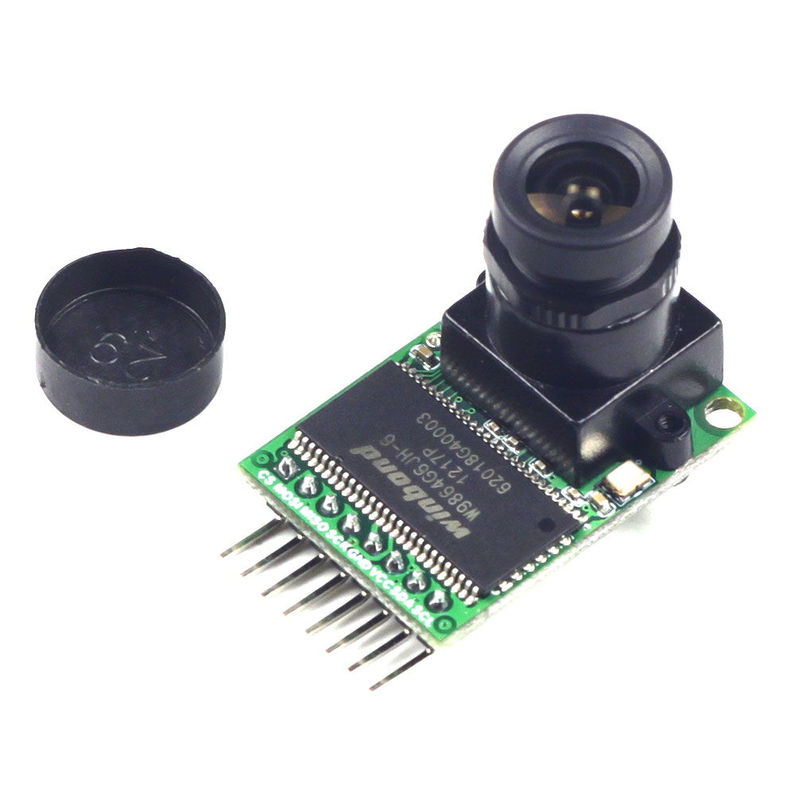
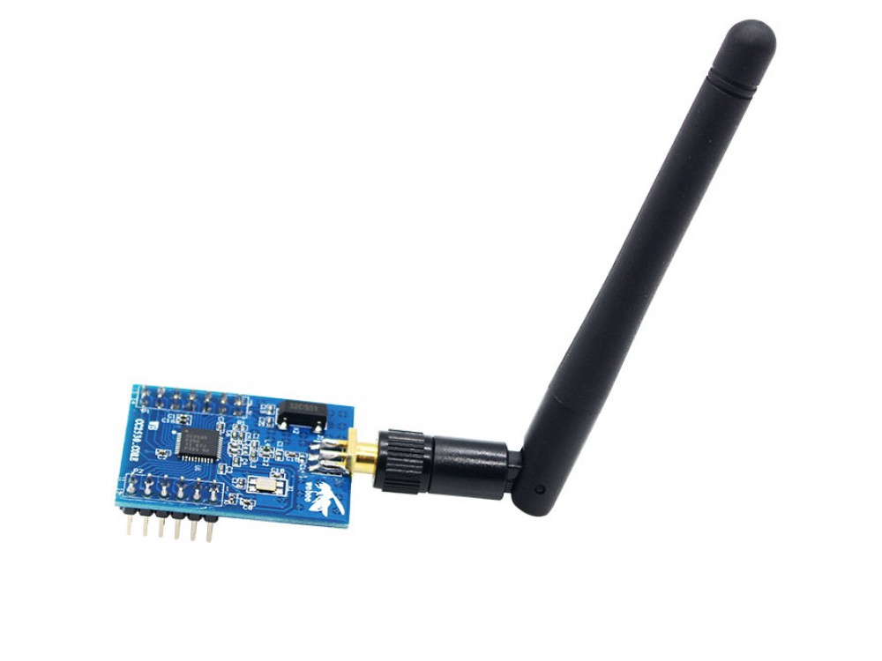
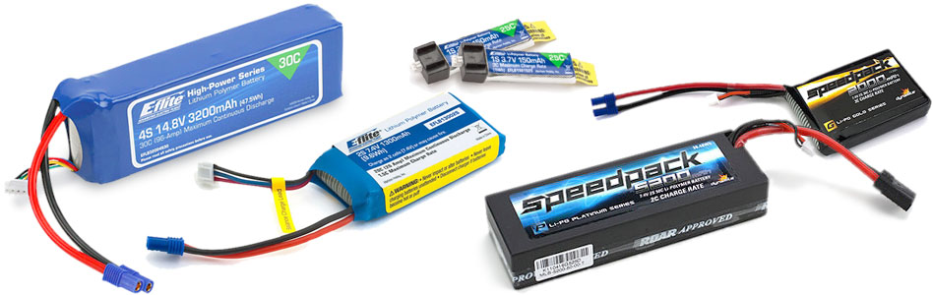
Proposed solution
Vision Based Volumetric Flow Measurement for wastewater and Storm water Networks
Notes:
Infrared camera
We might add lights aswell

Slide 9
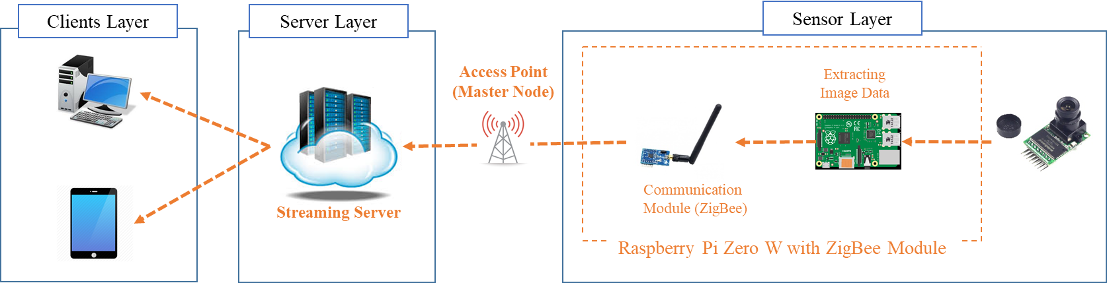
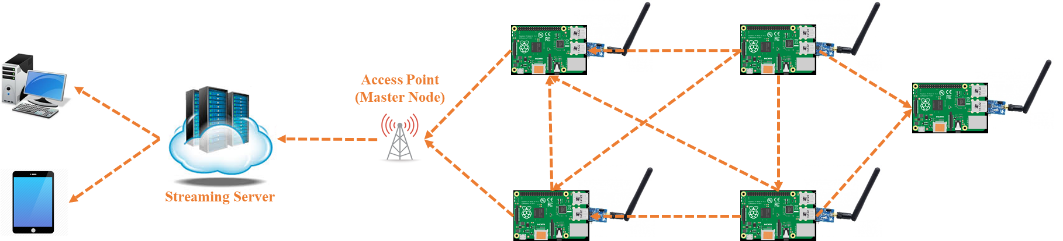
System Architecture
Notes:
Long range access
Range might be an issue !

Slide 10
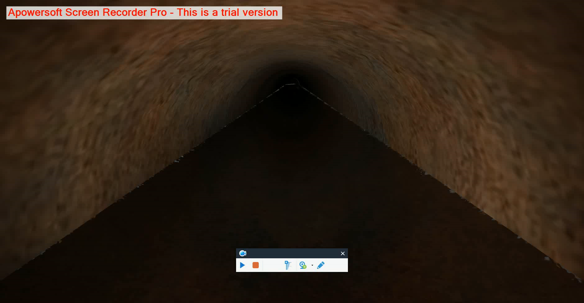
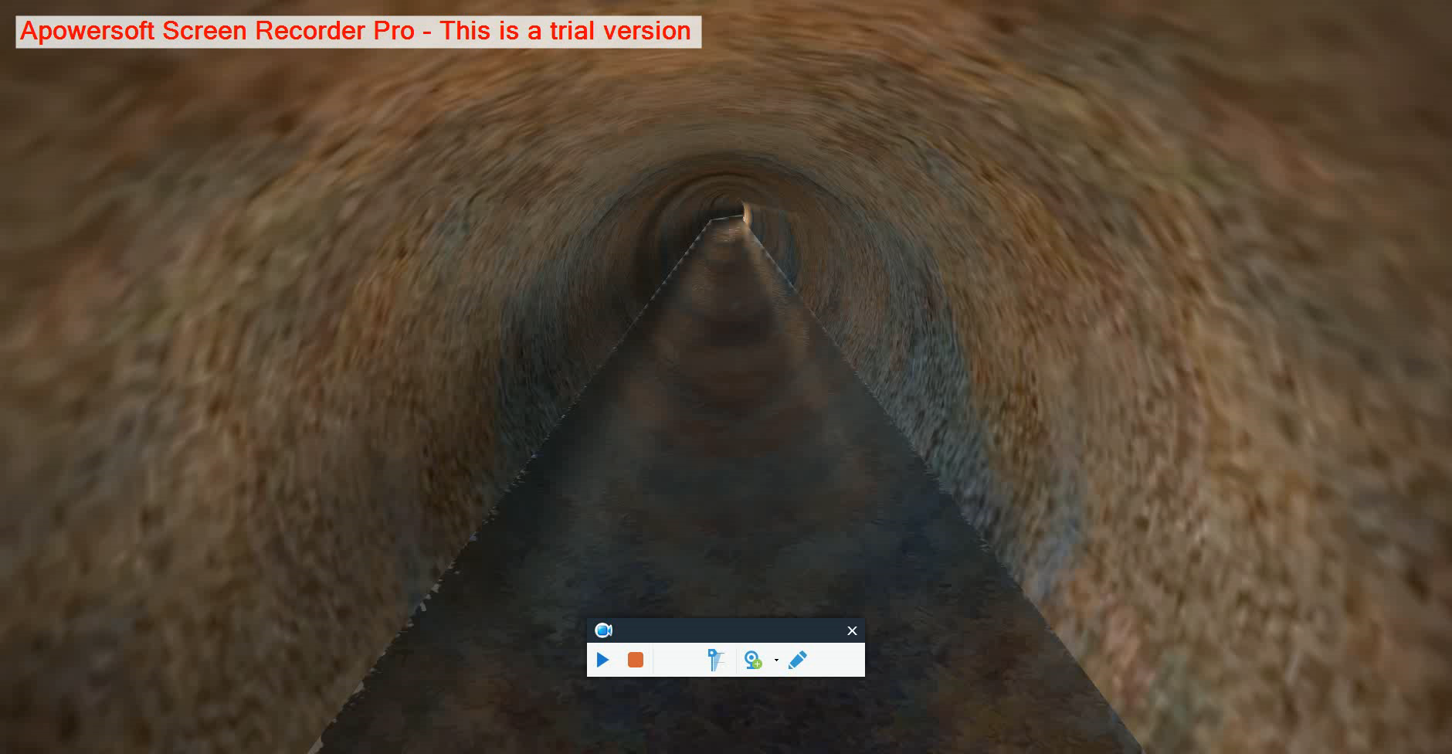
Pipe flow 3D models
Unity 3d engine
Different lightings

Slide 11
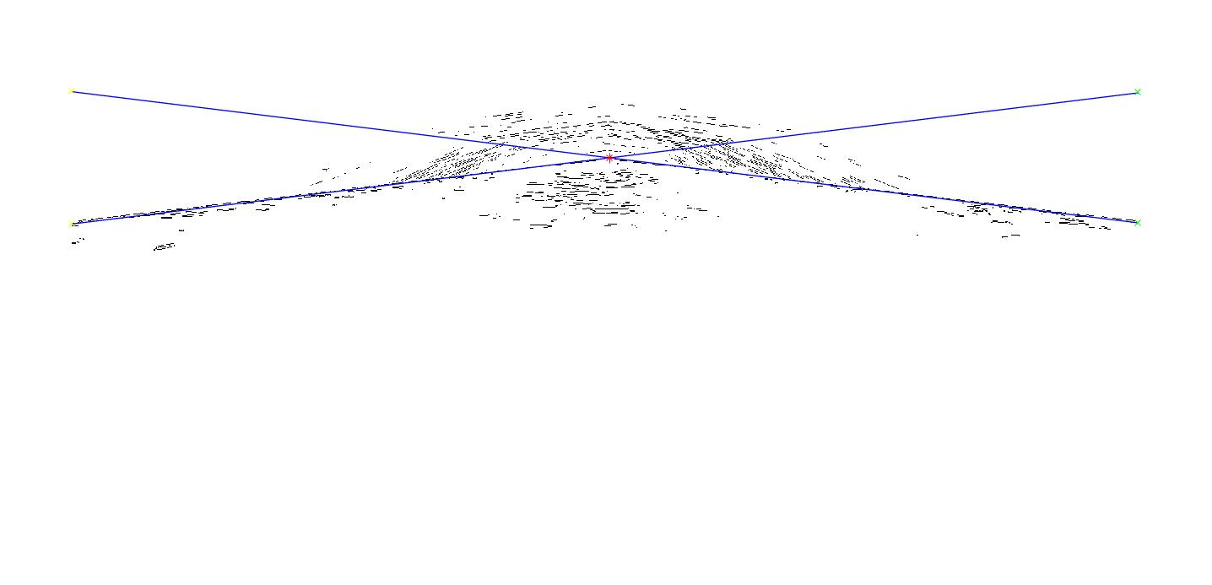
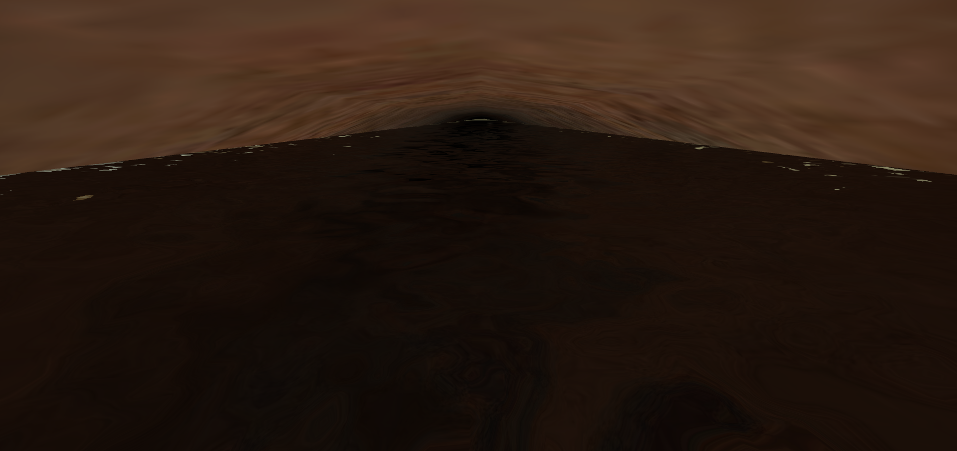
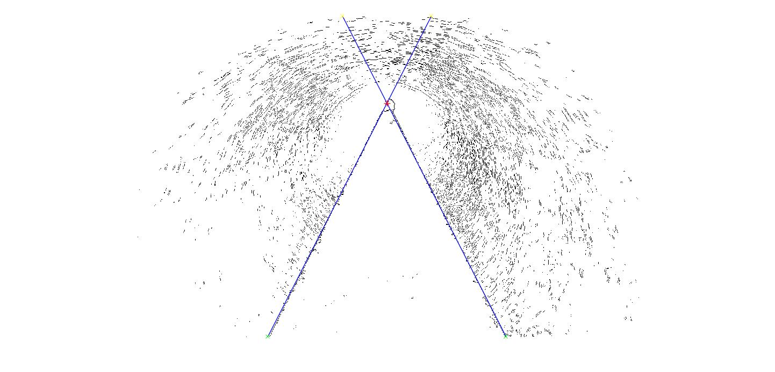
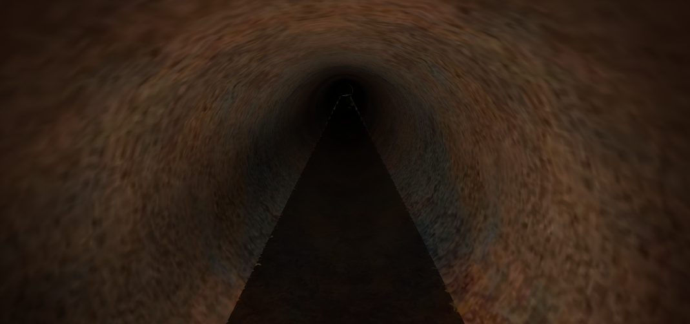
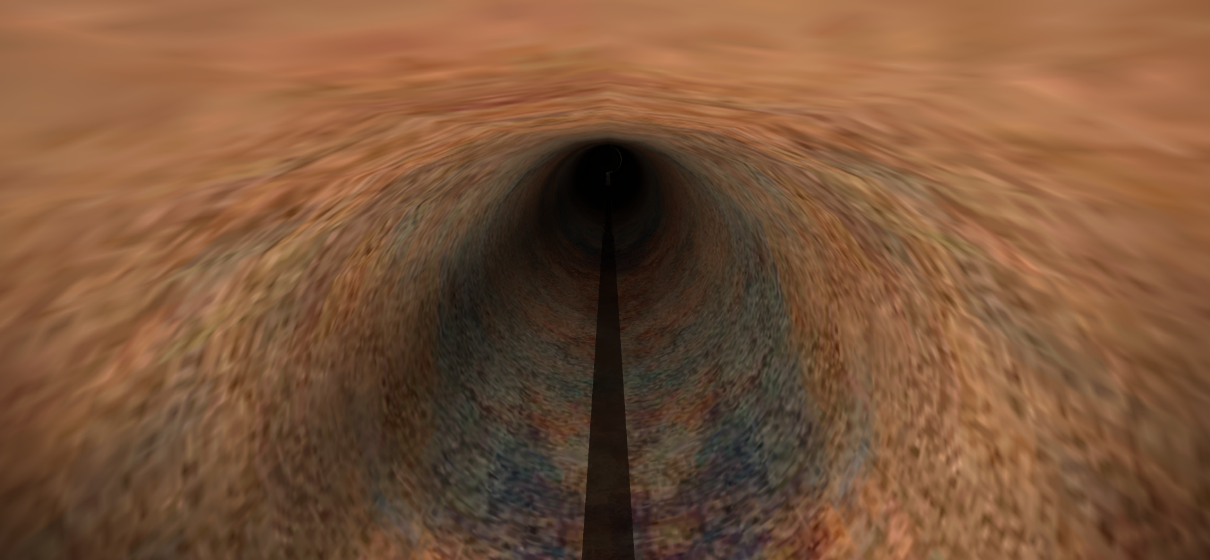
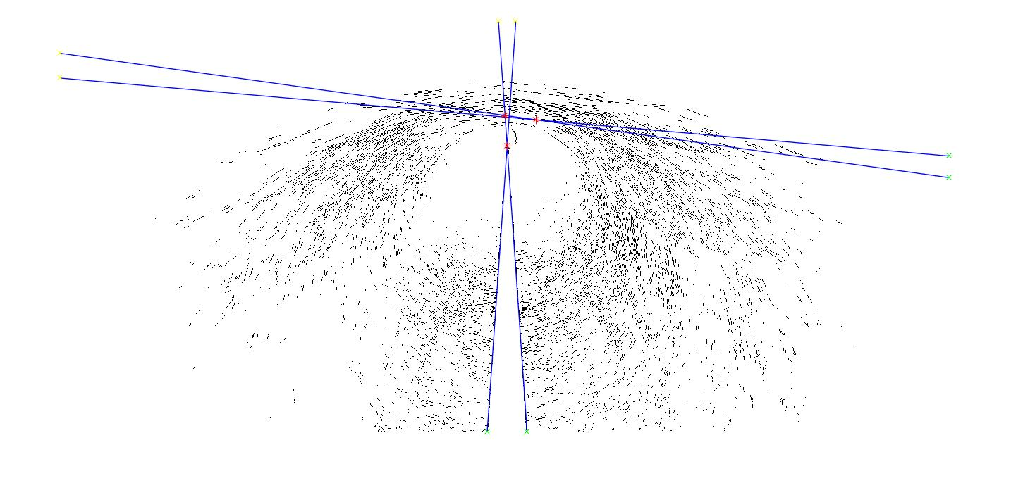
Image processing and vanishing lines
Edge Detection Filters
Notes:
Vanishing lines are perspective lines
Slope of the lines means the level of the water inside pipe

Slide 12
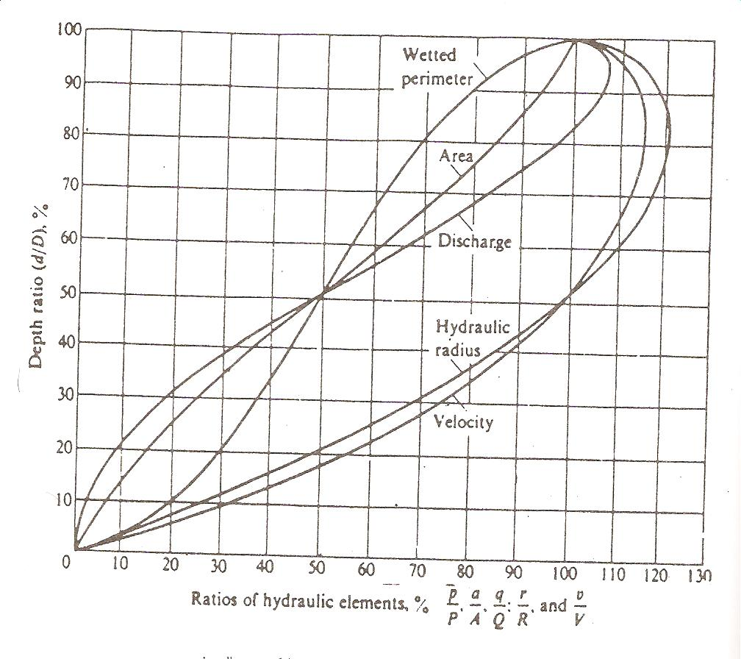
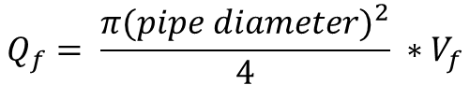
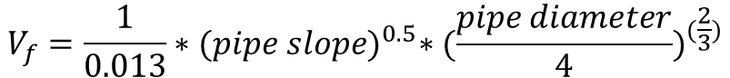
Results
Knowing the slope of the pipe:
Volumetric flow rate
Velocity
$$V_{f}=\frac{1}{0.013}∗{(pipe slope)}^{0.5}∗{(\frac{pipe diameter}{4})}^{(\frac{2}{3})}$$
$$Q_{f}= \frac{π{(pipe diameter)}^{2}}{4} ∗V_{f}$$

Slide 13
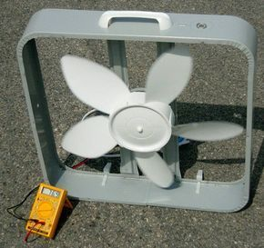
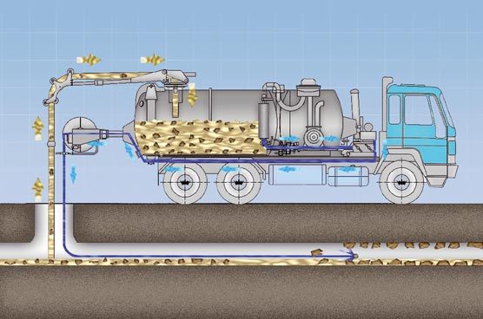
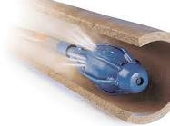
Limitations / Future Works
Low bandwidth with ZigBee
Limited battery lifetime (Energy harvesting using propellers)
Low computational power
Add water quality sensors
Water jets inside the pipes
Robotic Arms in order to Correct Small Issues
Measuring particle diameter inside pipes

Slide 14
Thank You

